Slide 1

RESPONSIBLE AI PROJECT
EMPLOYEE ATTRITION PREDICTION

Slide 2






Team Name:
AI-ddiction
MEET THE FAM
Our team is what really makes us tick. We are dreamers and creators to the core.
Atharva Saney
Akash Deshwani
Miliangiri Gauswami
Garima Chaudhary
Ahmedraza Sharif
Anurag Pandey

Slide 3
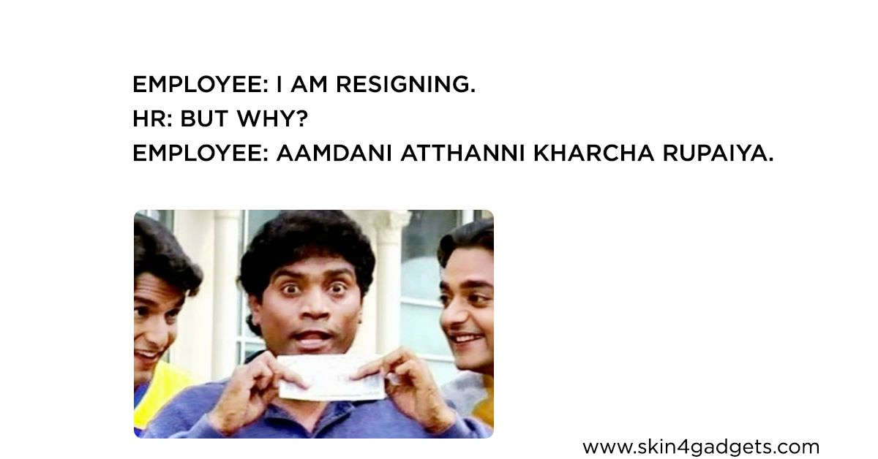

Slide 4



BUSINESS CASE
Attrition rate prognosis helps us with interpreting organizational data. It finds out the people-related trends in the data and helps the HR Department take appropriate steps to keep the organization running smoothly and profitably.
Causes of Attrition:
Need of Attrition Analytics
Business driven benefits
Job Dissatisfaction
Workforce demographics
Low job involvement
Business relocation
Employees looking for better opportunities.
Excessive working hours
What patterns can be revealed in employee turnover?
How long does it take to hire new employees?
What amount of investment for employee break-even (ideally 90 days)?
Which of our employees are most likely to leave within the year?
Reduced cost
Improve retention rate
Increased Productivity
Better talent management
Training and development

Slide 5
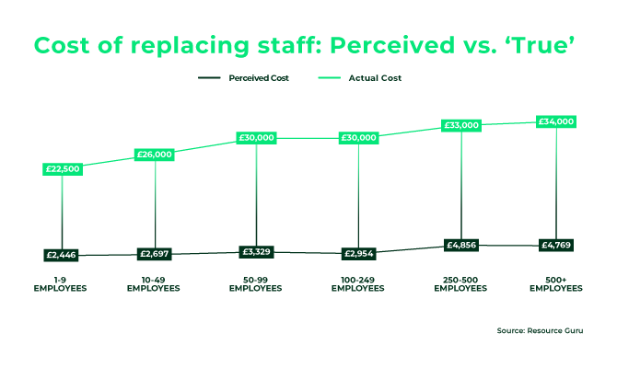
BUSINESS CASE
It normally takes 3 times the employees monthly salary, to effectively replace the employee.
From our data we see that average monthly salary is 6502 dollars. So it would take about $20000 to replace one employee.
This cost can be saved if we can predict attrition well in advance.
When attrition is expected and replacement standby is initiated at the right time, employee attrition CTC is down from 3x to 0.5x employees salary !
Perceived vs true cost of replacement of an employee at top UK companies

Slide 6
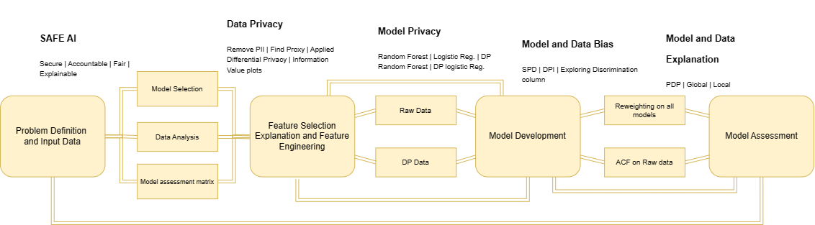

THE PROCESS OF ATTRITION ANALYTICS
Attrition analytics are made up of several components that feed into each other.
To gain the problem-solving insights that these analytics promise, data must first be collected.
The data then needs to be monitored and measured against other data, such as historical information, norms or averages.
This helps identify trends or patterns. It is at this point that the results can be analyzed at the analytical stage.
The final step is to apply insight to organizational decisions.
So let's start with our analysis!!!
4

Slide 7
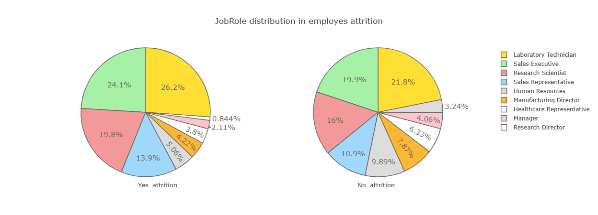
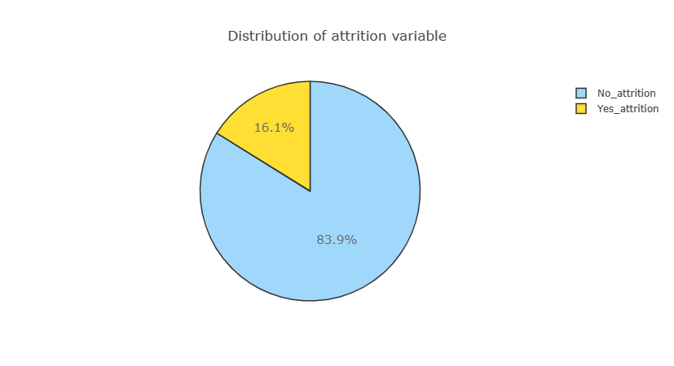
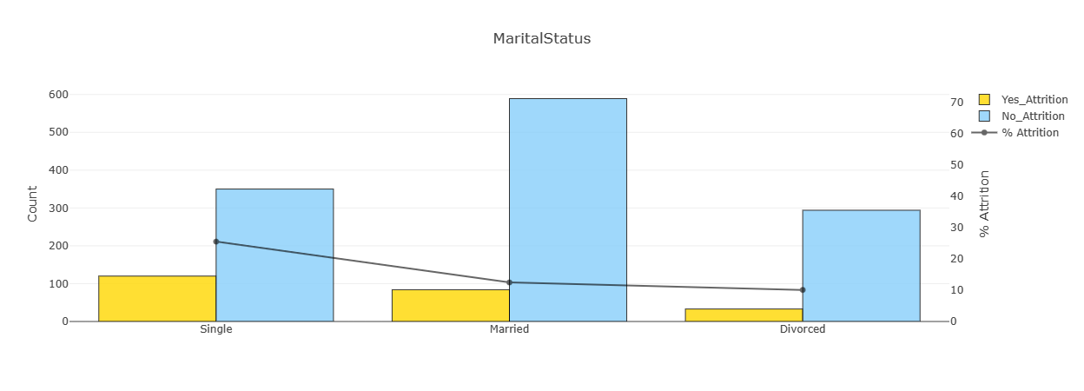
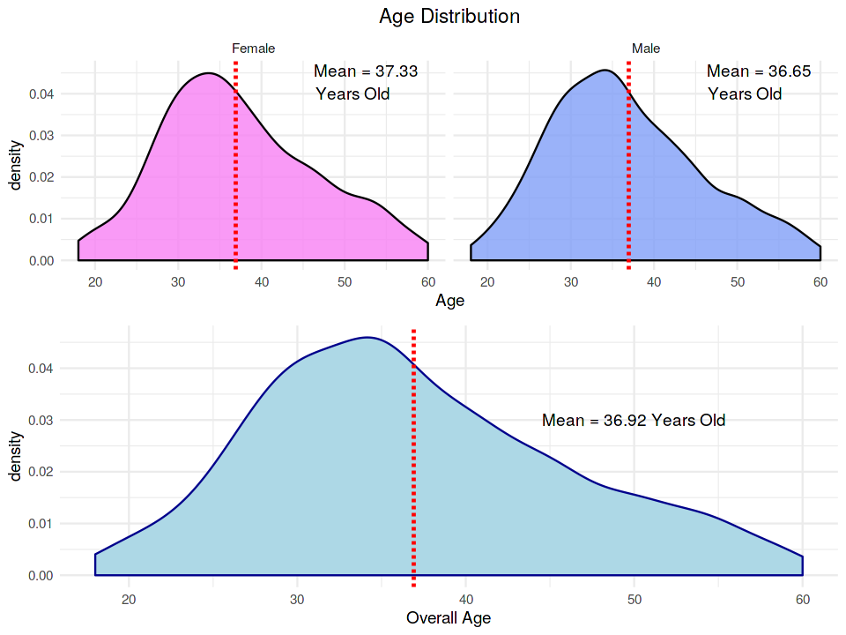
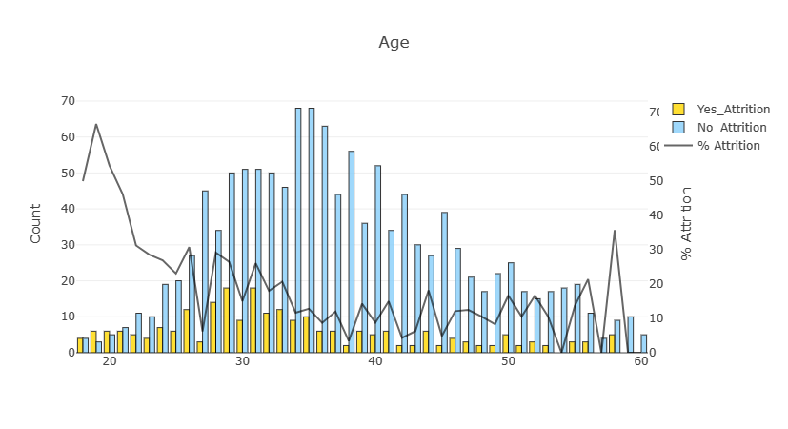
HOW DATA LOOKS
Dataset Structure: 1470 observations (rows), 35 features (variables)
Missing Data: Luckily for us, there is no missing data! this will make it easier to work with the dataset.
Target variable: Attrition (Yes/No)
Plotted various features against Attrition values to get value counts
Also plotted some important features with one another
Age by Gender: The average age of females is 37.33 and for males is 36.65 and both distributions are similar.
Job Satisfaction by Gender: For individuals who didn't leave the organization, job satisfaction levels are practically the same. However, for people who left the organization , females had a lower satisfaction level as opposed to males.
Feature Engineering: Ideal Emp | Under Valued Emp, were best predictor.
Feature Selection: Information value plots.
Notes:
Imbalanced dataset: 1237 (84% of cases) employees did not leave the organization while 237 (16% of cases) did leave the organization making our dataset to be considered imbalanced since more people stay in the organization than they actually leave.

Slide 8
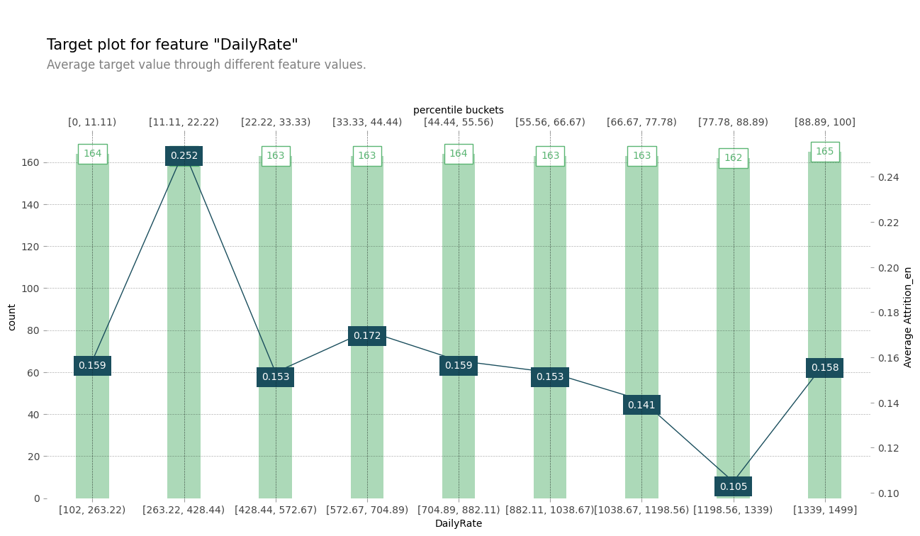
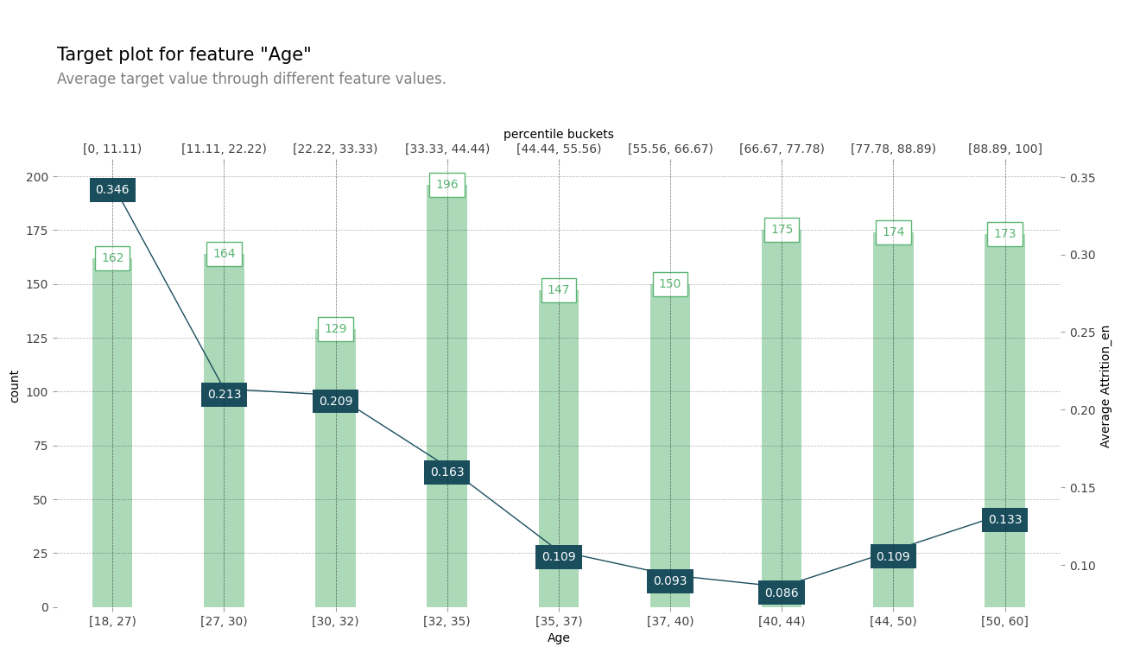
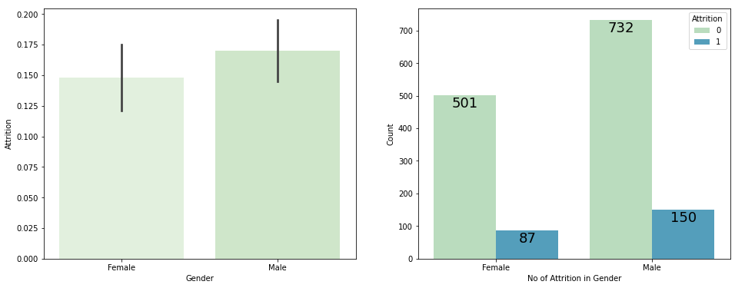
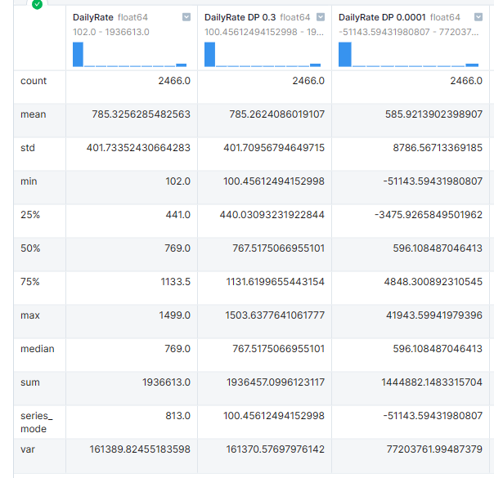
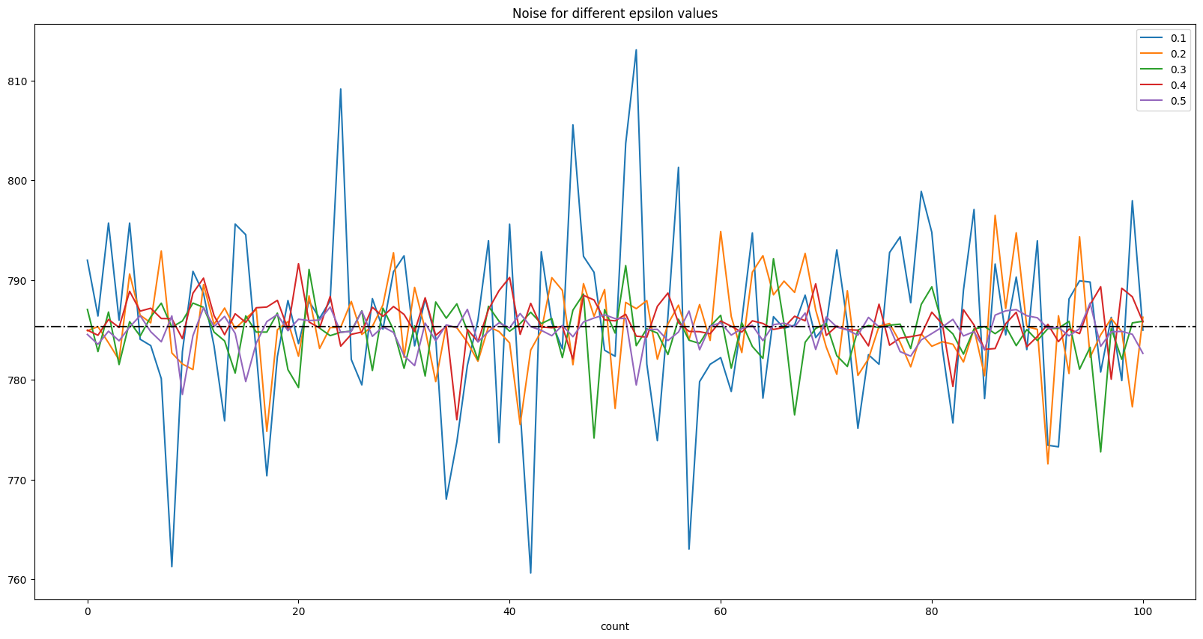
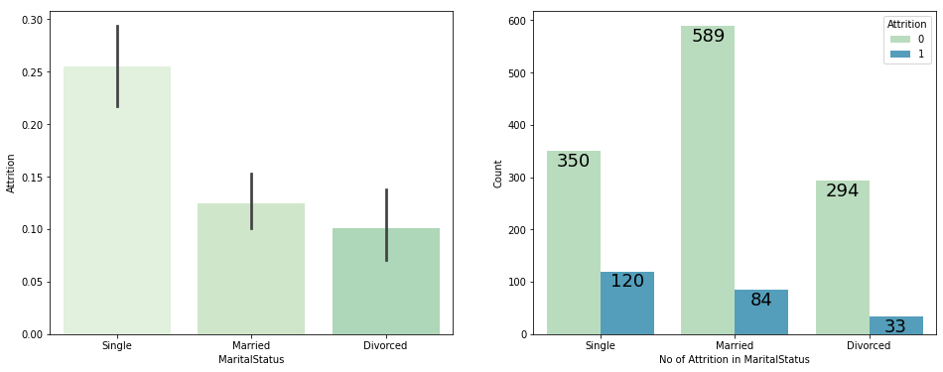
PII and Data Privacy
PII Data: Age | Gender | Marital Status | Emp No.
Removed PII | Detecting Proxy | apply Differential Privacy.
Consider VIF as a primary eliminator. Use mutual information technique to detect proxy features, and see cosine distance, just to be sure.
For eg, Age is a PII column, so we will apply DP on its proxy feature, which is 'DailyRate’.
Notes:
Amazon found that their machine learning-driven recruiting tool was showing bias against women applicants. They ended up scrapping the tool.
Google’s photo recognition AI led to coloured people being misidentified as primates.

Slide 9
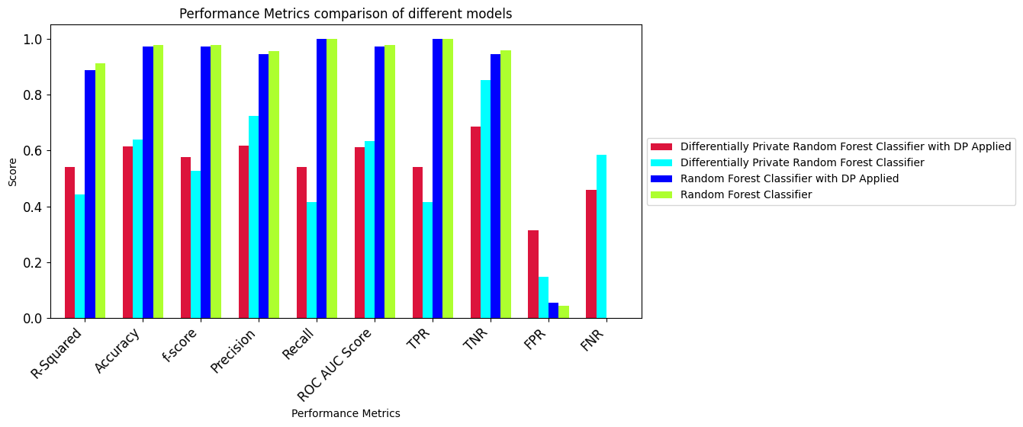
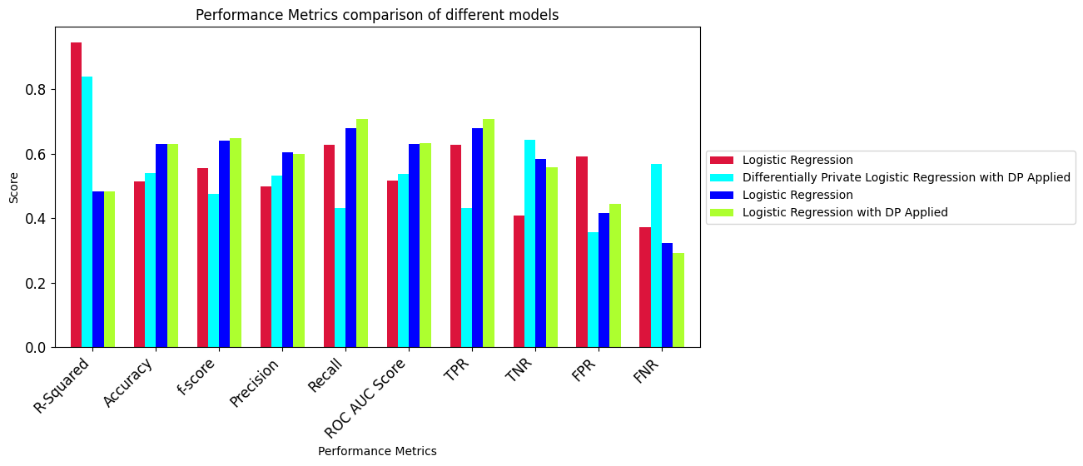
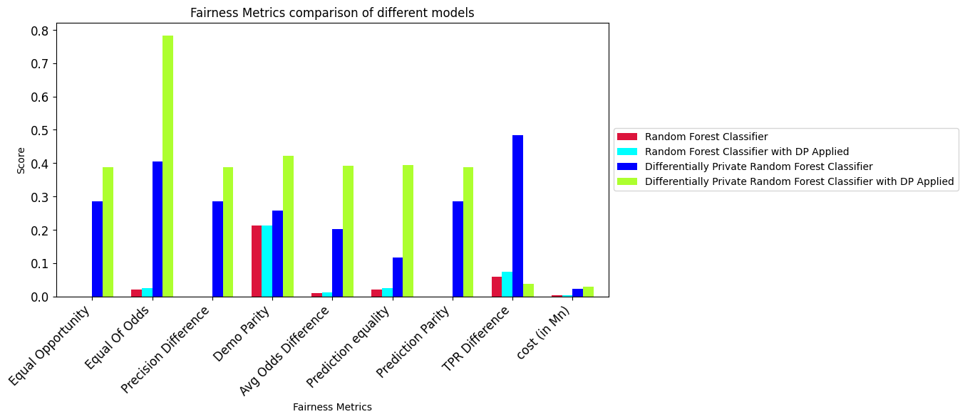
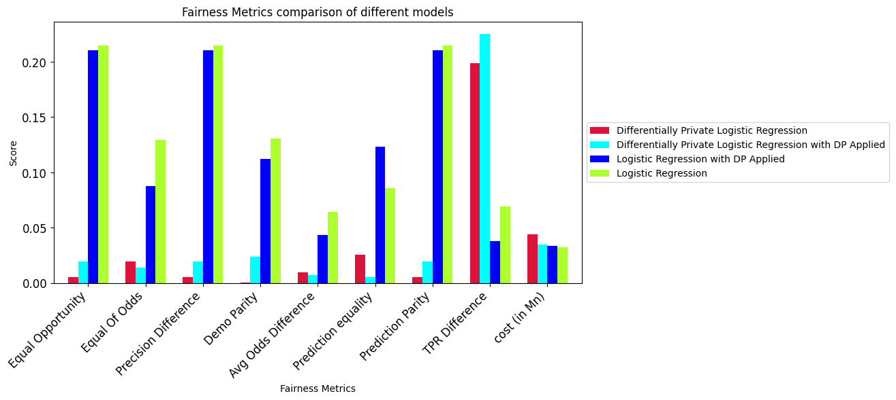
Model development
Random Forest
Logistic Regression Key Insights
Random forest performs equally well with and without DP in data in terms of accuracy, R-squared, f-score, precision and recall.
DP logistic regression with DP in data performs better then DP random forest with DP in data while in other cases random forest out performs Logistic Regression
Logistic regression doesn't discriminate well in terms of any parameters. DP random forest on DP data highly discriminates between prev and unprev, and has large difference in equal opportunities, TPR, Demographic parity, EoD and precision.

Slide 10
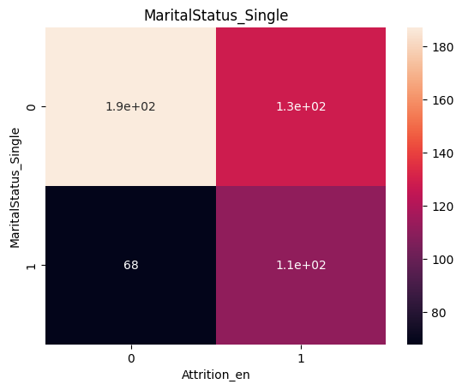
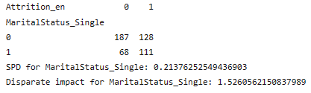
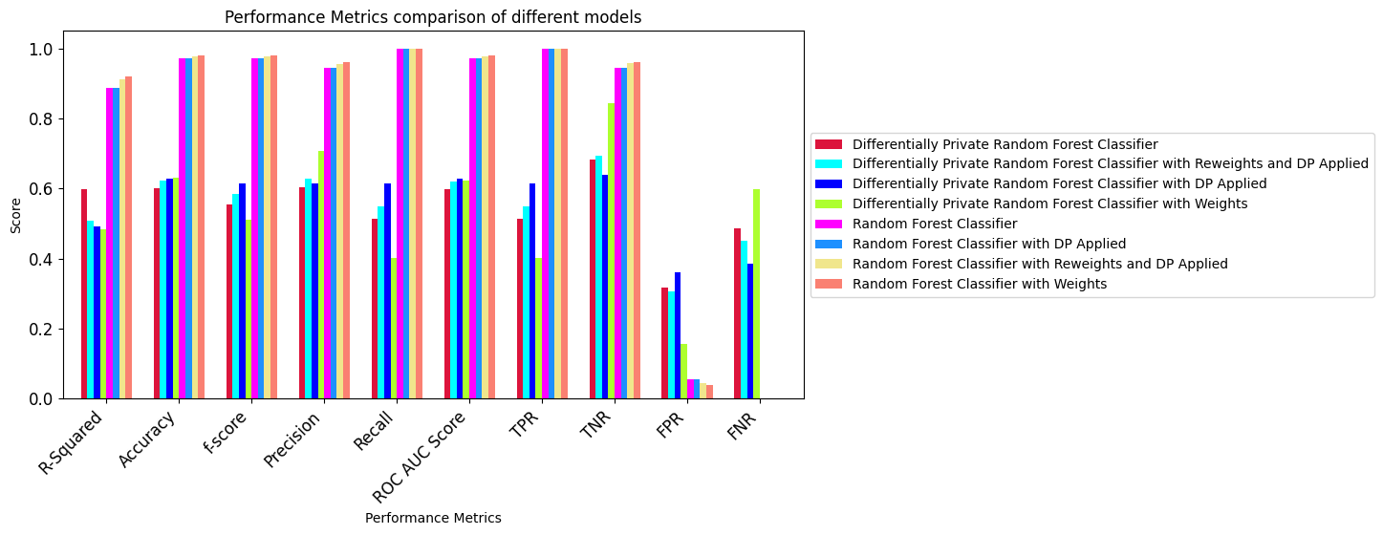
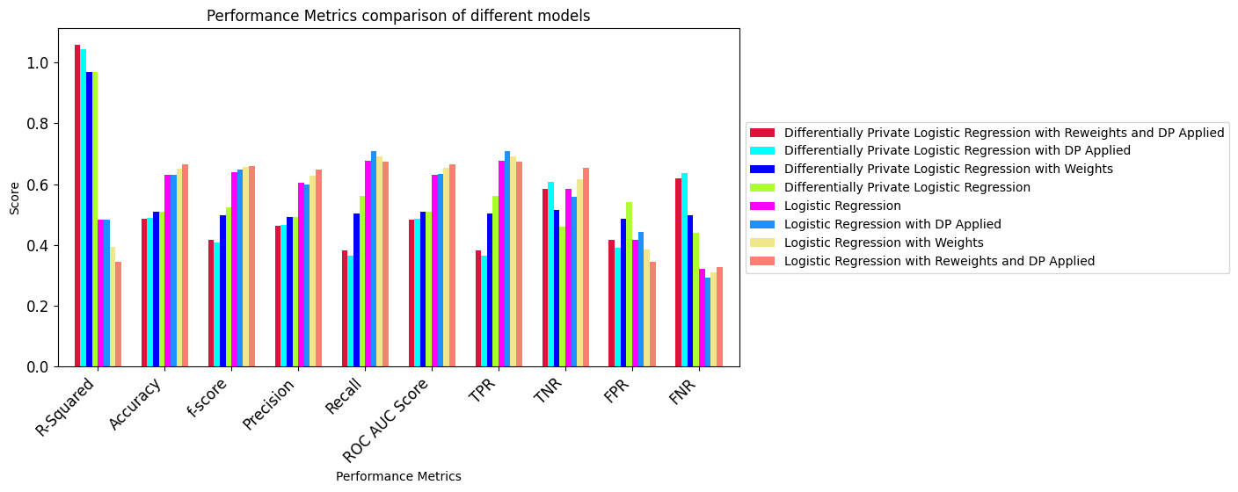
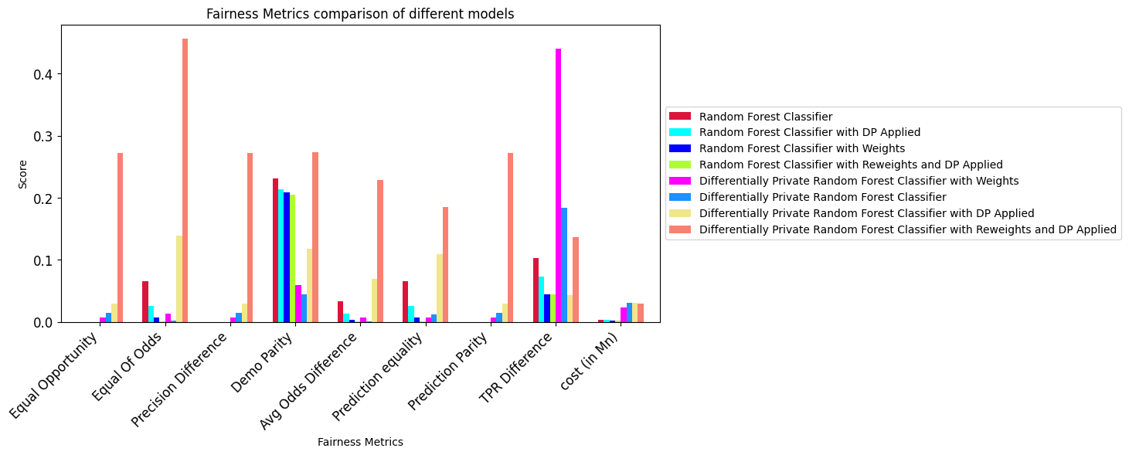
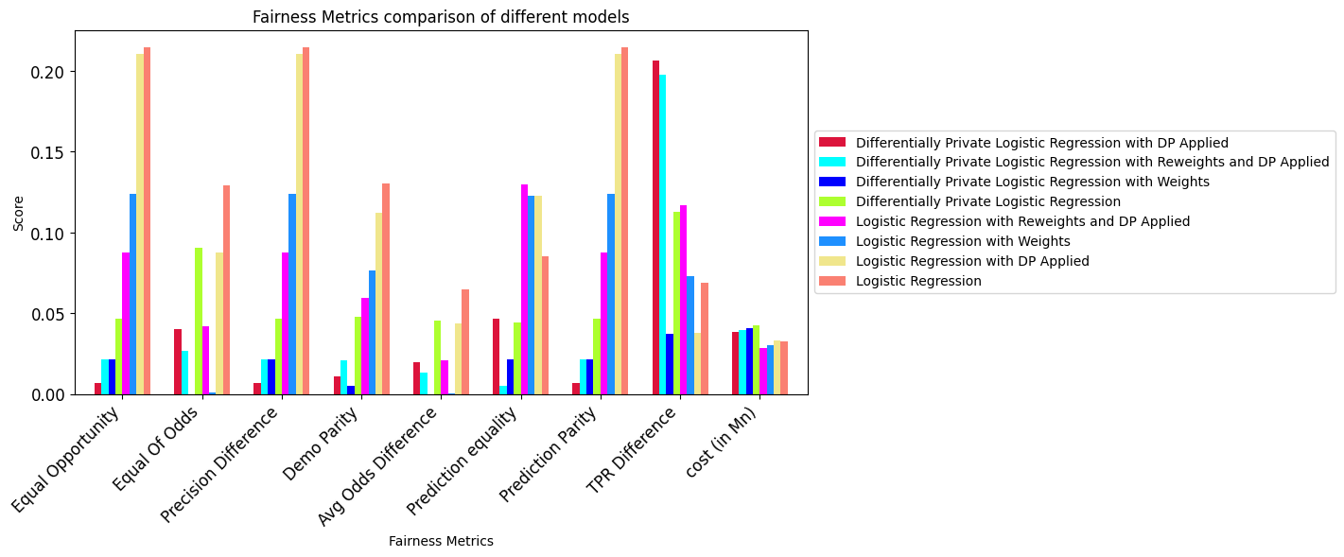
SPD | DPI
Reweights
Model Dev.
Model and Data Bias - Reweighting
Random Forest Logistic Regression
SPD for ‘Marital status’ feature is 0.22
This proved presence of bias, to remove it we must apply reweighting.
Final weights after calculation: 0.8695, 1.3588, 1.1906, 0.7801
After reweighting, best performer is RF with weights. Fairness is still better in LR, but RF shows better fairness then earlier.

Slide 11
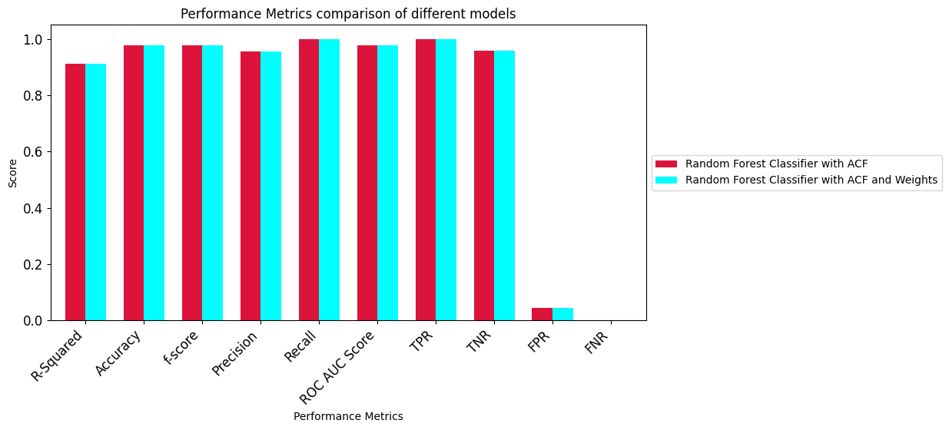
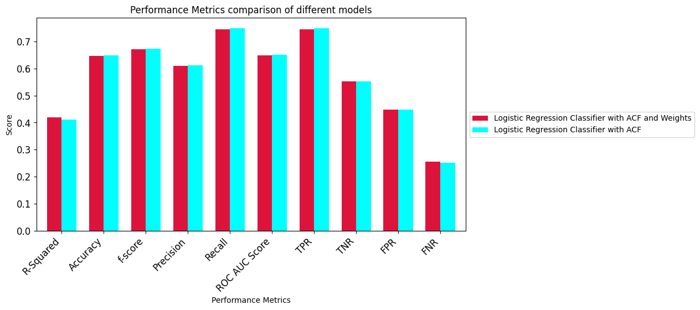
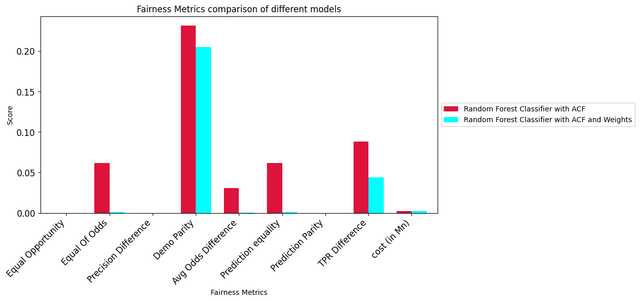
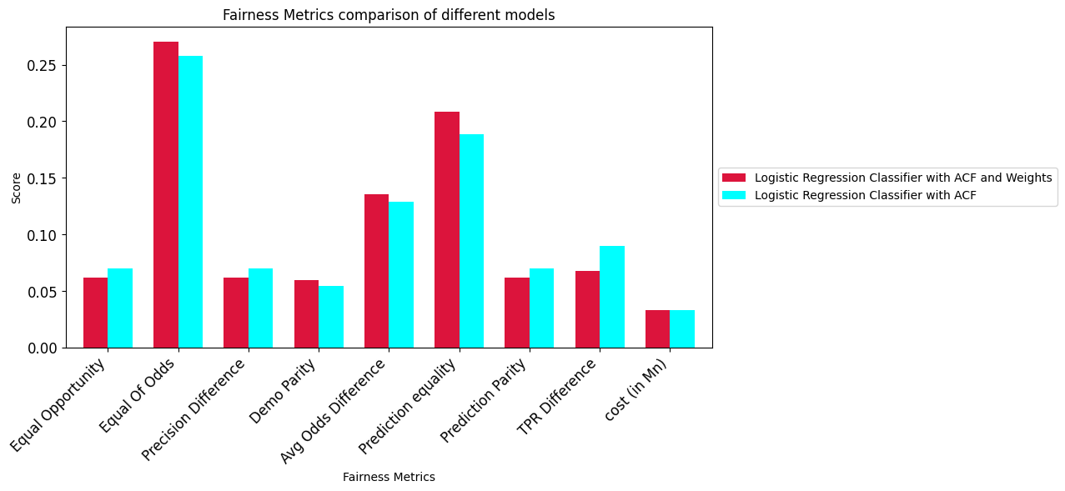
Eliminates the effects of PII columns on Data
Model and Data Bias - ACF
Random Forest
Logistic Regression
Key Insights
Performance of RF with ACF and weights is equivalent to that of RF with ACF but better than LR with ACFand LR with ACF and weights
Applying reweighting improves Fairness metrics on random forest ACF, but, not on LR with ACF.

Slide 12
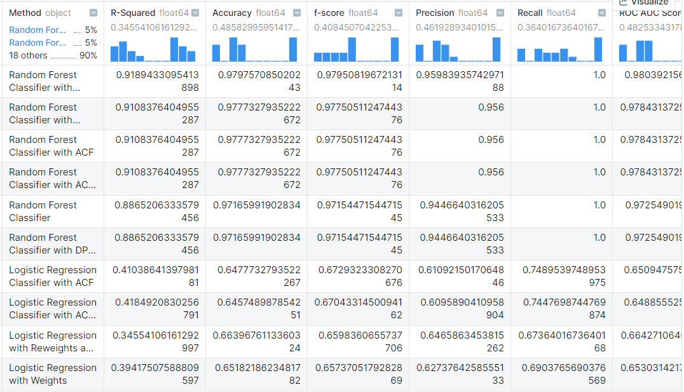
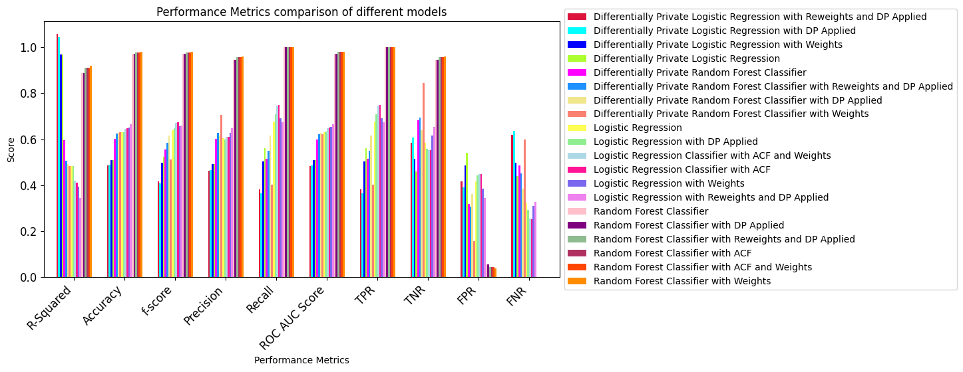
Even more confusing!!
Selecting the best model​
Too Tedious and boring !!

Slide 13
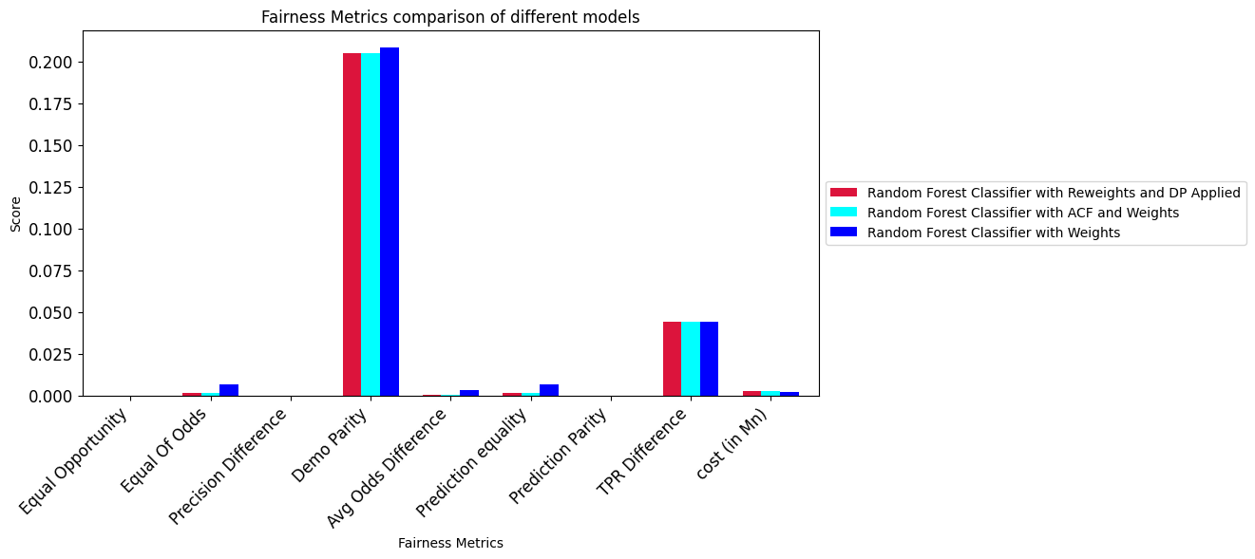
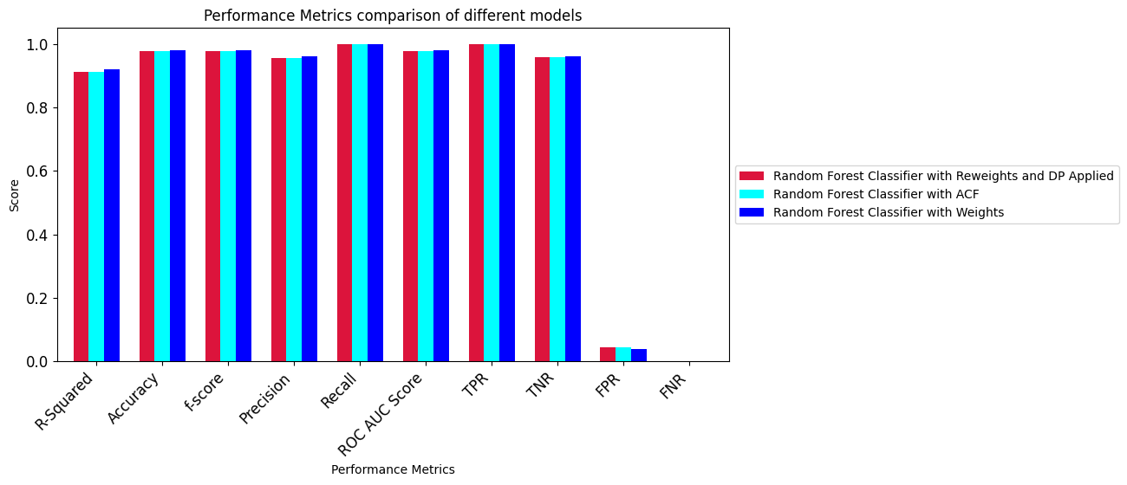
Selecting the best model​
We compared all 20 models in terms of performance and fairness metrics and selected the top 3 models, given below:
Insights: As per the performance metrics random forest classifier with weights had highest R squared, accuracy, f-score and precision ​
As per the fairness metrics Random forest classifier with Reweights and DP on data applied had the best EoD, EO, demographic parity etc.​

Slide 14
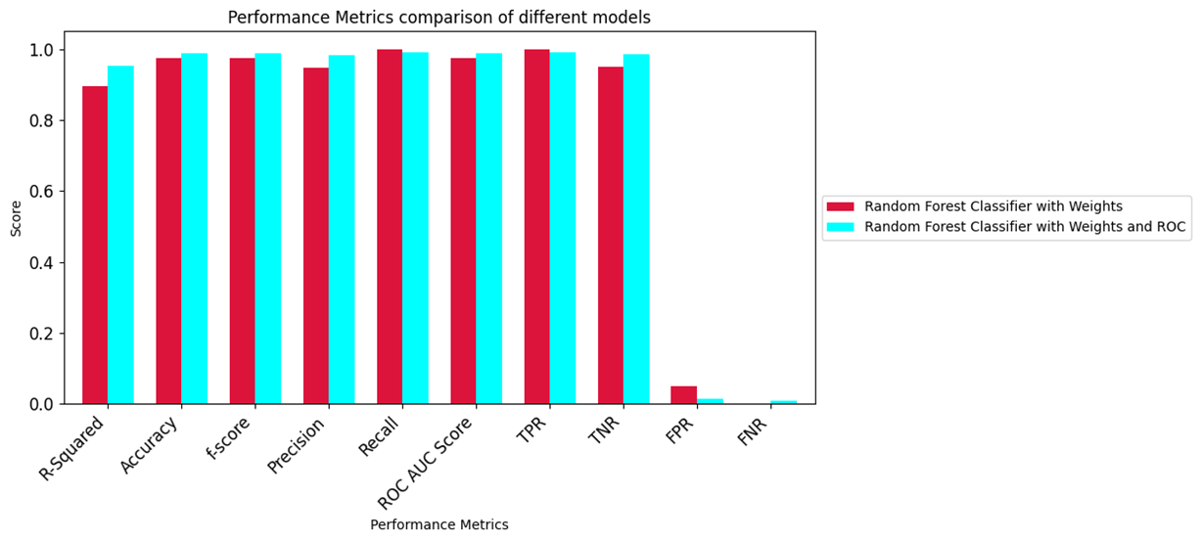
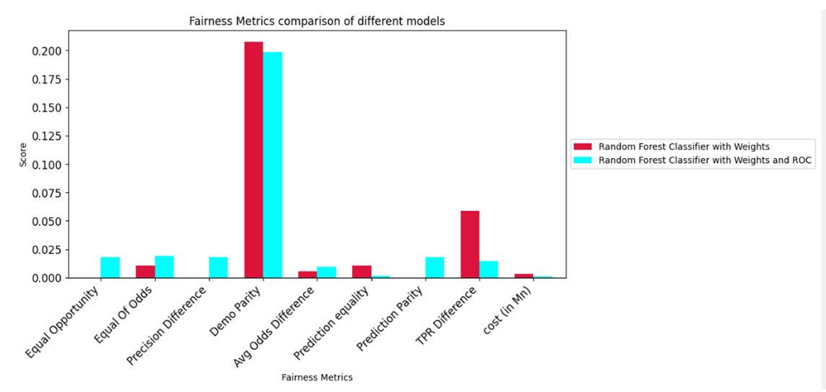
Reject Option Classifier
Finally, we applied Reject option classifier (ROC) on the best selected model, and the results were astonishing.
We had over 98% accuracy score, f-score, etc and very low FNR and FPR
Our fairness metrics are also well within the acceptable range. So we are now ready to deploy this model.

Slide 15
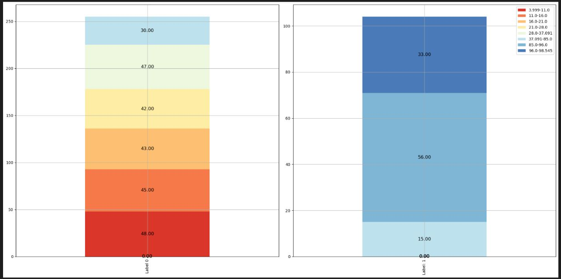
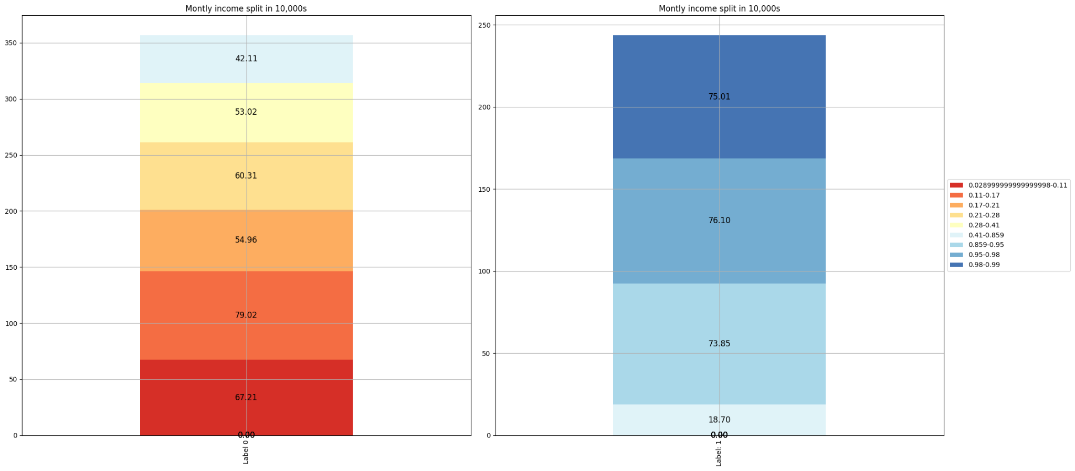
Split quantiles for no of employees
Split quantiles for
Sum of income of employees

Slide 16
Back to Business
Looking at the split quantiles, we see that 45 (17%) employees lying in 41 to 85 percentile were in grey area (risk).
So in the current scenario, our risk has been reduced to 17% employees, from initial of 100% employees.
From split quantiles (for salary), we see this number comes out to be $600,000.

Slide 17
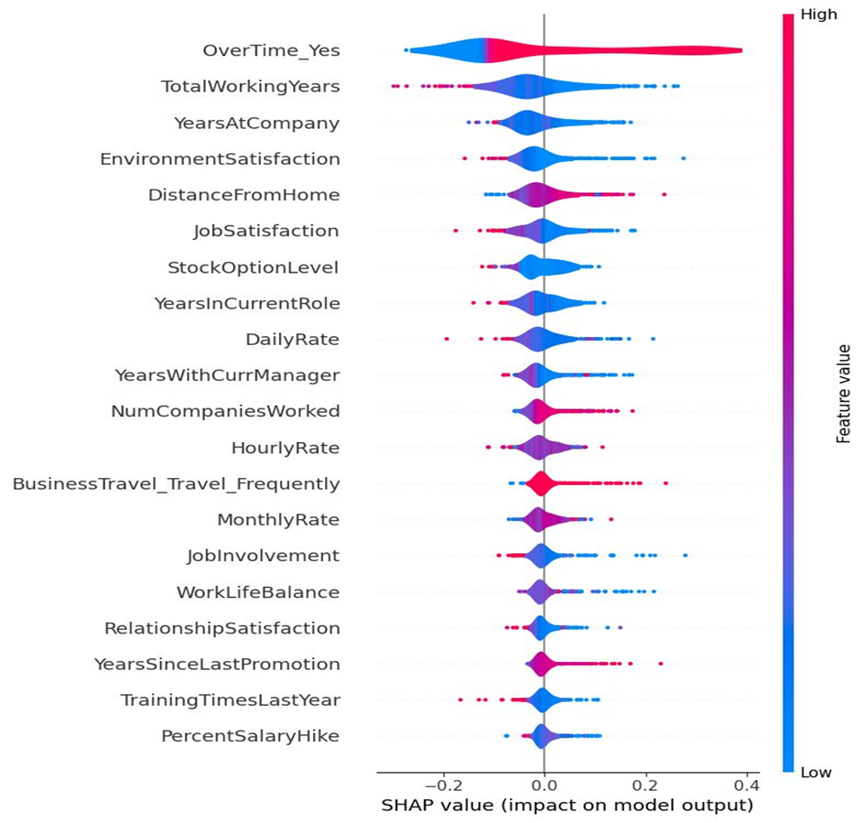
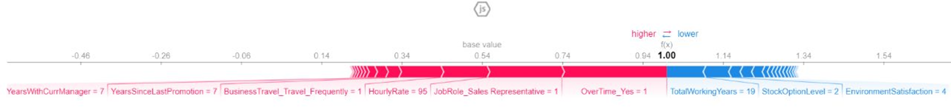
Explainable AI
From SHAP graph, we can see that the most significant features are Overtime, total working years and Years at company.
From momentum graph, we can derive the counterfactuals. Reduce overtime, hire someone with more working years, increase the hourly rate etc. this will push employee from Attrition to no attrition.
So, we can deduce what are the probabilities of any employee leaving, and plan accordingly.
We can either take steps to ensure employee retention or keep a standby replacement for employees whose Attrition probability is high, or BOTH.
Momentum Graph

Slide 18
Conclusion
So we have created a very good (not the best!) model for prediction of employee attrition.
We have ensured privacy of data, so that individual cannot be identified.
After are data exploration and modelling, we checked and removed any bias model may have (hence, no lawsuits !!).
We checked for model and data explainability, derived proper counterfactuals (yeah, credibility to AI !!)
Finally, we calculated the actual risk we may be taking post the deployment of the model, so our boss is happy.

Slide 19
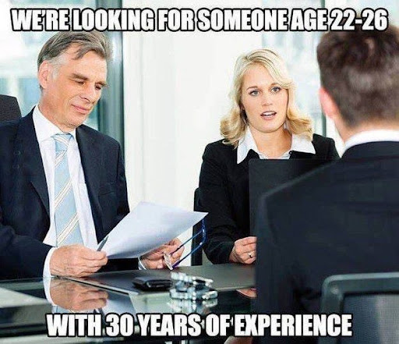

Slide 20
Thank you!

